Slide 1
Bidirectional Photon Mapping
Jiří Vorba Charles University in Prague Faculty of Mathematics and Physics
Notes:
Name, master student of CG at Ch.U. in Prague

Slide 2
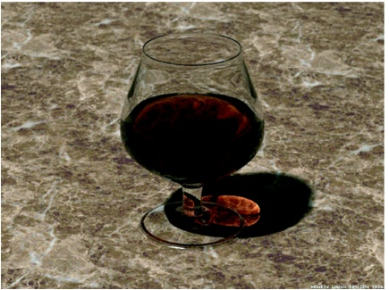
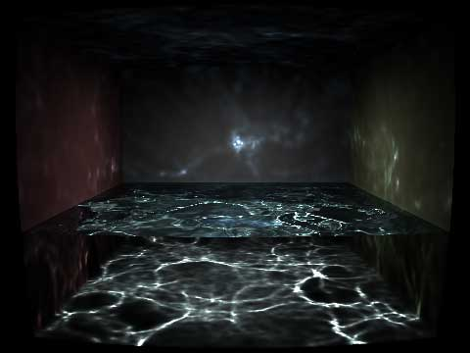
Motivation
Goal: Robust Global Illumination
Photon Mapping good at:
Caustics
Reflections of caustics
Small light sources
Photon Mapping bad at:
Glossy scenes
© H.W.Jensen
© Wojciech Jarosz
Notes:
New robust method for computing GI based on photon mapping
Why do we concern with looking for a new robust method?
PM is good at rendering scenes with difficult light settings.
Wide range of scenes which PM does not handle properly.
Problematic scenes contain many glossy materials.

Slide 3
Our contribution
Photon Mapping
Notes:
An example of such a problematic scene.
Cornell box-like scene with solely glossy materials.
Blotchy artifacts and grainy noise
To the right: our bidirectional approach

Slide 4
Outline
Review of Photon Mapping (Jensen et al.)
Main idea
Algorithm overview
Results
Application to progressive methods
Conclusion
Notes:
Briefly review the PM algorithm
Present the main idea of our approach
Give an algorithm overview
Show our results
Also present the results of our implementation into the progressive PM methods

Slide 5
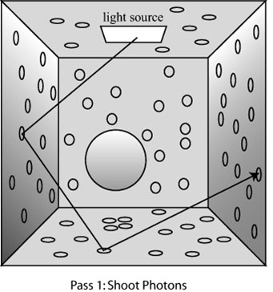
Photon Mapping review
First pass
Photon shooting
Overall lighting approximation
© Kavita Bala
Notes:
Two passes
In the first pass: shoot photons, trace them through the scene, store information about photon-surface interactions
Photon map data structure
Approximates the overall lighting of the scene

Slide 6
Photon Mapping review
Second pass
Light path connection heuristic
Secondary rays
PM
query
Primary rays
BRDF lobe
Notes:
Approximation in photon map used during the second pass
Computing the pixel values, tracing primary rays into the scene, when the surface is hit, algorithm decides whether to estimate the reflected radiance from the photon map or another level of distribution ray-tracing
Decision depends on the type of a material and on the type of the lighting
Important:
Second pass as it is suggested by Jensen – heuristic which tells us when to connect the light path by estimating the reflected radiance

Slide 7
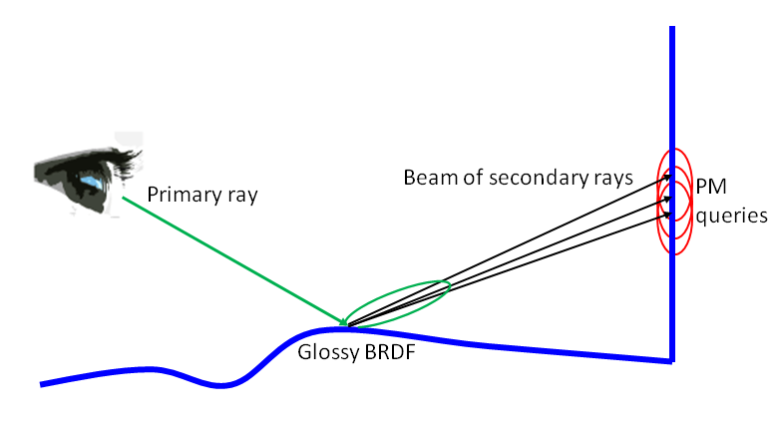
PM issues
Correlated queries
Notes:
Two problems cause that the PM produce the artifacts…
There is the first one.
Directly visible glossy surfaces rendered by one level of distrib. Ray-tracing
Narrow BRDF peak => beam of secondary rays
Hit the surface close to their origin , photon map queries are correlated (contain the same photons), averaging of the error contained in the photon map is not achieved

Slide 8
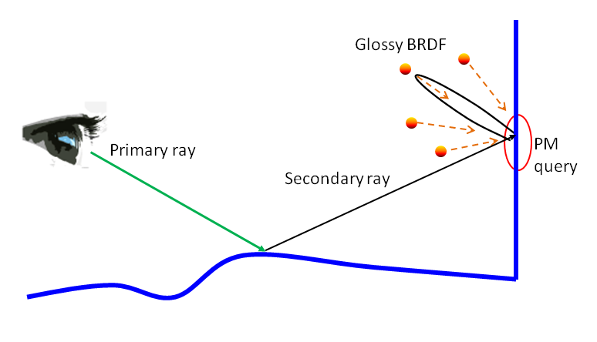
PM issues
Radiance estimate variance
Notes:
The undiserable effects of the first problem are boosted by the second one.
Secondary ray hits another glossy surface, narrow BRDF peak acts as a filter of photon directions, only few photons coming from the right direction contributes to the final radiance estimate => the radest. Suffers from high variance
Both issues combined result into the blotchy artifacts and noisy images

Slide 9
Main idea
PM
query
PM
query
PM
query
Notes:
How to cope with the problems?
Second pass heuristic fails on glossy scenes. Some scenes and even some parts of the light transport would need to connect light paths after one bounce of camera ray and others after more bounces.
Idea: to connect light paths in every bounce of the camera ray, do not know in advance which particular scene we are given
This brings a new problem. Obviously the same light transport is computed multiple times.

Slide 10
1st strategy
PM
query
Notes:
Example of a particular light path which contribution is included multiple times.
One segment generated from camera, three segments generated from light, connected through the radiance estimate.

Slide 11
2nd strategy
PM
query
Notes:
Radiance estimate performed in the second camera path bounce,
Contribution of the same light path included, this time 2 segments from the camera and 2 from a light source

Slide 12
3rd strategy
PM
query
Notes:
Etc. etc. so we end up with few different strategies which compute the same light transport.
Every strategy is advantageous for a different type of light transport.

Slide 13
Strategy combination
Multiple importance sampling (Veach 97)
Notes:
How do we combine various strategies?
MIS
MIS solves the very same problem in the algorithm of BDPT
For every path the weight is computed and the path contribution is multiplied by that weight.
The path weight is evaluated according to the way of generating the path.
If the path can be generated from three different strategies -> weights evaluated as it is shown on the slide
Details of computing the probabilities P are given in the article itself

Slide 14
Algorithm overview
First pass
the same as in PM
Second pass
Path-Tracing
Radiance estimate at every path vertex
light path contribution multiplied by MIS weight
Notes:
How the Bidirectional Photon Mapping algorithm looks like?
Heuristic replaced by the path-tracing

Slide 15
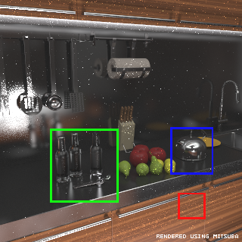
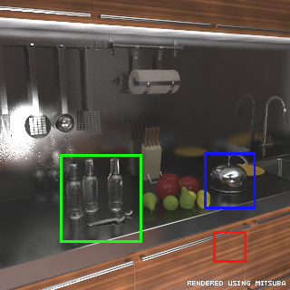
Results
Photon Mapping
Our Bidirectional Photon Mapping

Slide 16
Application to progressive methods (not a part of the CESCG article)
Overcoming the memory limits
Solving finer details
Consistent method
Our implementation
Based on Stochastic Progressive PM

Slide 17
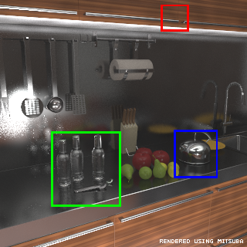
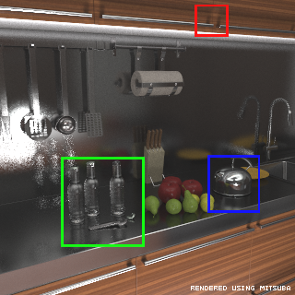
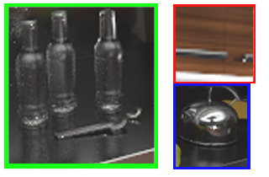
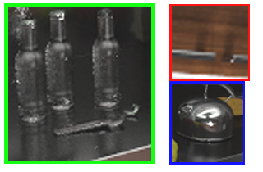
Progressive results
Our bidirectional method (not progressive)
Our progressive bidirectional method

Slide 18
Results
Photon Mapping
Progressive Bidirectional Photon Mapping
Notes:
robustni alg. Vyvinuty na zaklade PM

Slide 19
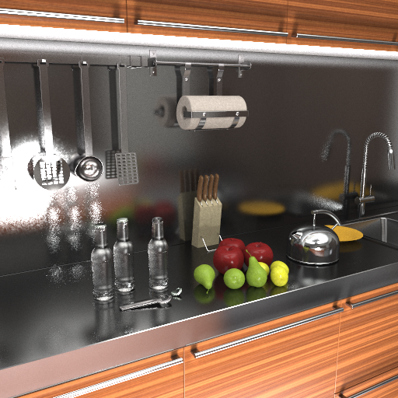
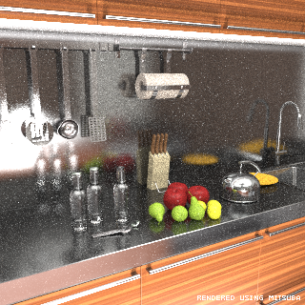
Results
Reference - PT
(320x320, 4 days on 6 cores)
PBDPM (512x512, 1 day 3h on 6 cores)
Notes:
Nejak popsat

Slide 20
Limitation
Bias introduced by an inappropriate MIS weights
“gap” between a photon hit and a camera ray end point
Our assumption
PM
query
Reality
PM
query

Slide 21
Conclusion
Contribution
New more robust photon mapping based method
Future works
“Area light source” strategy
Compensate the bias introduced by inappropriate MIS weights

Slide 22
The end
Reference - PT
(320x320, 4 days on 6 cores)
Thank you!
Questions?
PBDPM (512x512, 1 day 3h on 6 cores)

